Slide 1

Assignments 3 and 4
Rebus Enhancements
(Group Assignment)
Siva R Jasthi
ICS499 Sofware Engineering and Capstone Project
Fall 2017
Information and Computer Sciences
Metropolitan State University
Unrestricted

Slide 2
Prerequisites
1. Download “rebus.zip” from D2L assignments folder.
2. Extract the contents to “htdocs/rebus” in your local xampp
3. Open and review the contents of “db_configfuration.php”
4. Create a database (suggested name “'icsbinco_rebus')
5. Import icsbinco_rebus.sql (located in sql_scripts\for importing) into your database.
6. Update db_configuration.php to reflect the user name and password of your local deployment.
7. Launch http://localhost/rebus and play with it
8. Login as “admin/admin” to see the admin features

Slide 3
Goals of A3 and A4
You will be exploring an application developed in Summer ICS499 course.
You will enhance the application by adding new functionality.
In this process, you will realize how the three tiers (Client- HTML and JavaScript; Server – PHP, Database – MySQL) interact with each other.
This is also a group project. You will get to know each other before embarking on a bigger final project.

Slide 4

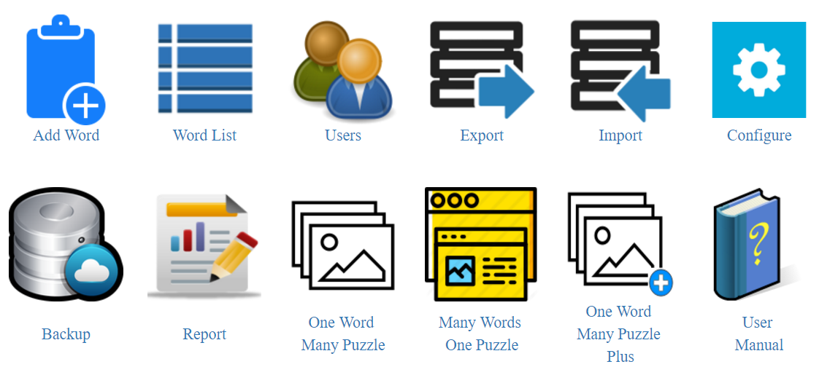
Assignment 3:
Many From a List
https://cdn1.iconfinder.com/data/icons/hawcons/32/698552-icon-40-clipboard-list-128.png
In Assignment 3, you will add a new action called “Many From a List”
This action will show up under ADMIN actions as follows.
Clicking on that icon will show a page called “many_from_a_list.php”
Assig
https://cdn2.iconfinder.com/data/icons/snipicons/500/list-128.png
Many from
A List

Slide 5
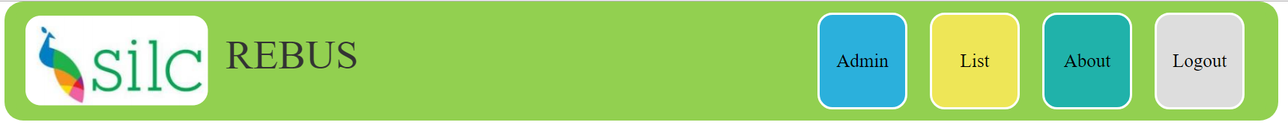
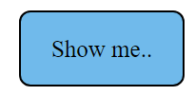
Assignment 3: many_from_a_list.php
Cl
Rebus Puzzle (Many from a List)

Slide 6
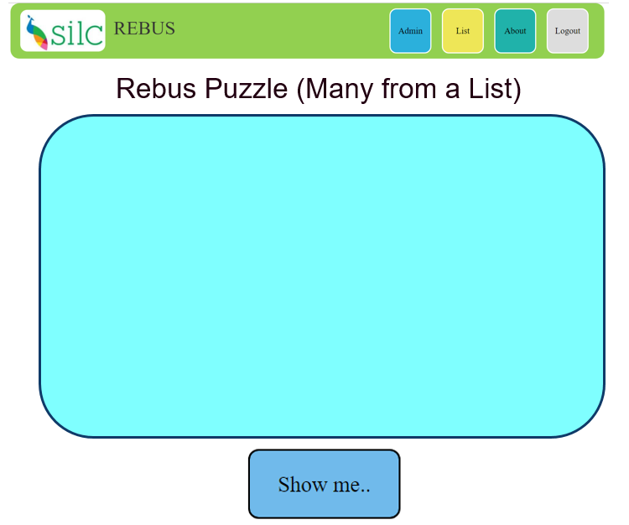
Assignment 3: many_from_a_list.php
User enters a bunch of words, one per line.
You can assume that there can be a maximum limit of 100 words.
When the user clicks “Show me..”, the system generates a puzzle for each word, trying to make it from other words.
Basically, it makes use of the temporary list of words without going to the database.
So, it behaves like “One Word Many Puzzles” but without going to the database. And it also doesn’t make use of IMAGES.
As in “One Word Many Puzzles”, the words that are already used will NOT be used while generating the subsequent puzzles.
Clicking on “Show me..” will take the user to a new php file called “generate_many_from_a_list.php”

Slide 7
Assignment 3: generate_many_from_a_list.php
Cl
Input Word List:
one, two, three, four, five, six…., one hundred
Puzzles
one = 3/3 (two) + 1/4 (nine) + 4/5 (three)
two = 1/5 (three) + 2/6 (twelve) + 2/4 (four)
…
…
99 ….
100. One hundred: 8/12 (eighty four) + ?? (not enough words to generate)
In

Slide 8

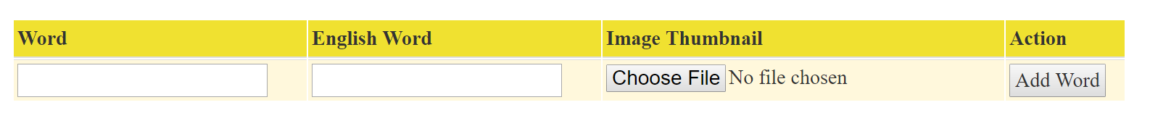
Assignment 4: Set based Add
In this assignment, you will enhance “Add Word” functionality to support set based inserts.
We can only add one word at a time to the database.
You will enhance the UI and backend functionality to support the addition of upto 10 words.
Here is the current UI.
Notes:
8

Slide 9
Assignment 4: Add Words
Add Words
The new “Add Words” UI will be as follows
The user can add one or more words in this user interface (maximum of 10 words)
User may or may not upload the images for all the words.
Clicking “Add Words” will create all the words in the database.
Notes:
9

Slide 10
What to submit?
Assignment 3:
admin.php
many_from_a_list.php
generate_many_from_a_list.php
Assignment 4: add_words.php (new file)
I do not anticipate that you need to change any other file.
If you are changing any other file, let me know while submitting to D2L
Notes:
10

